Slide 1
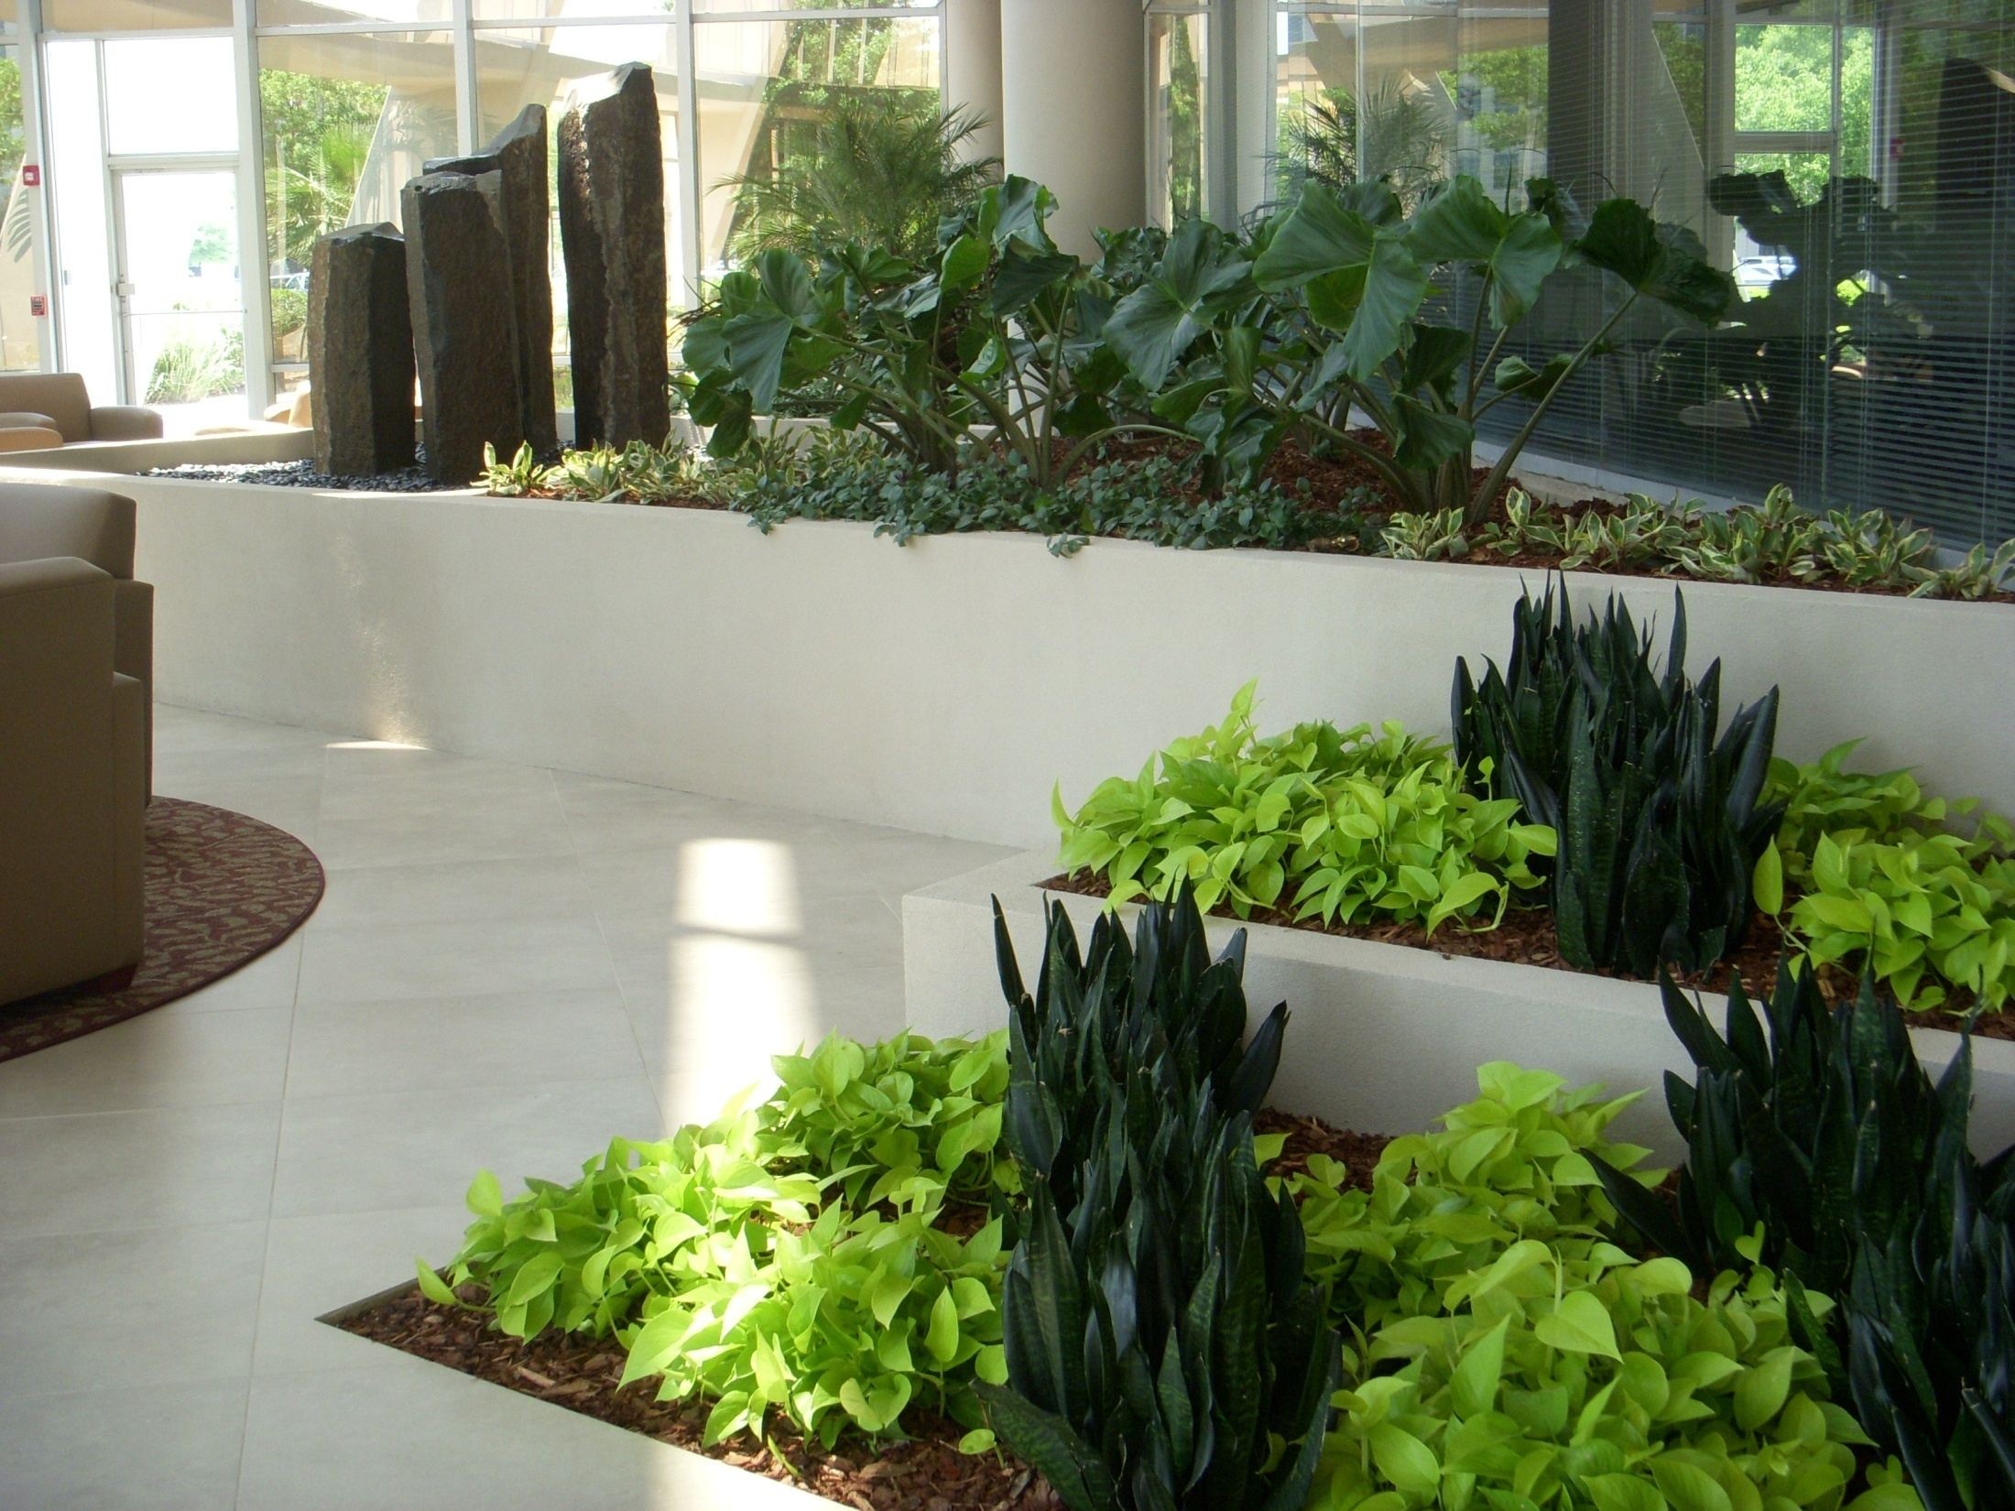
Why Green?
Notes:
Photo: Mike Lewis, Foliage Design Systems, Orlando, FL

Slide 2
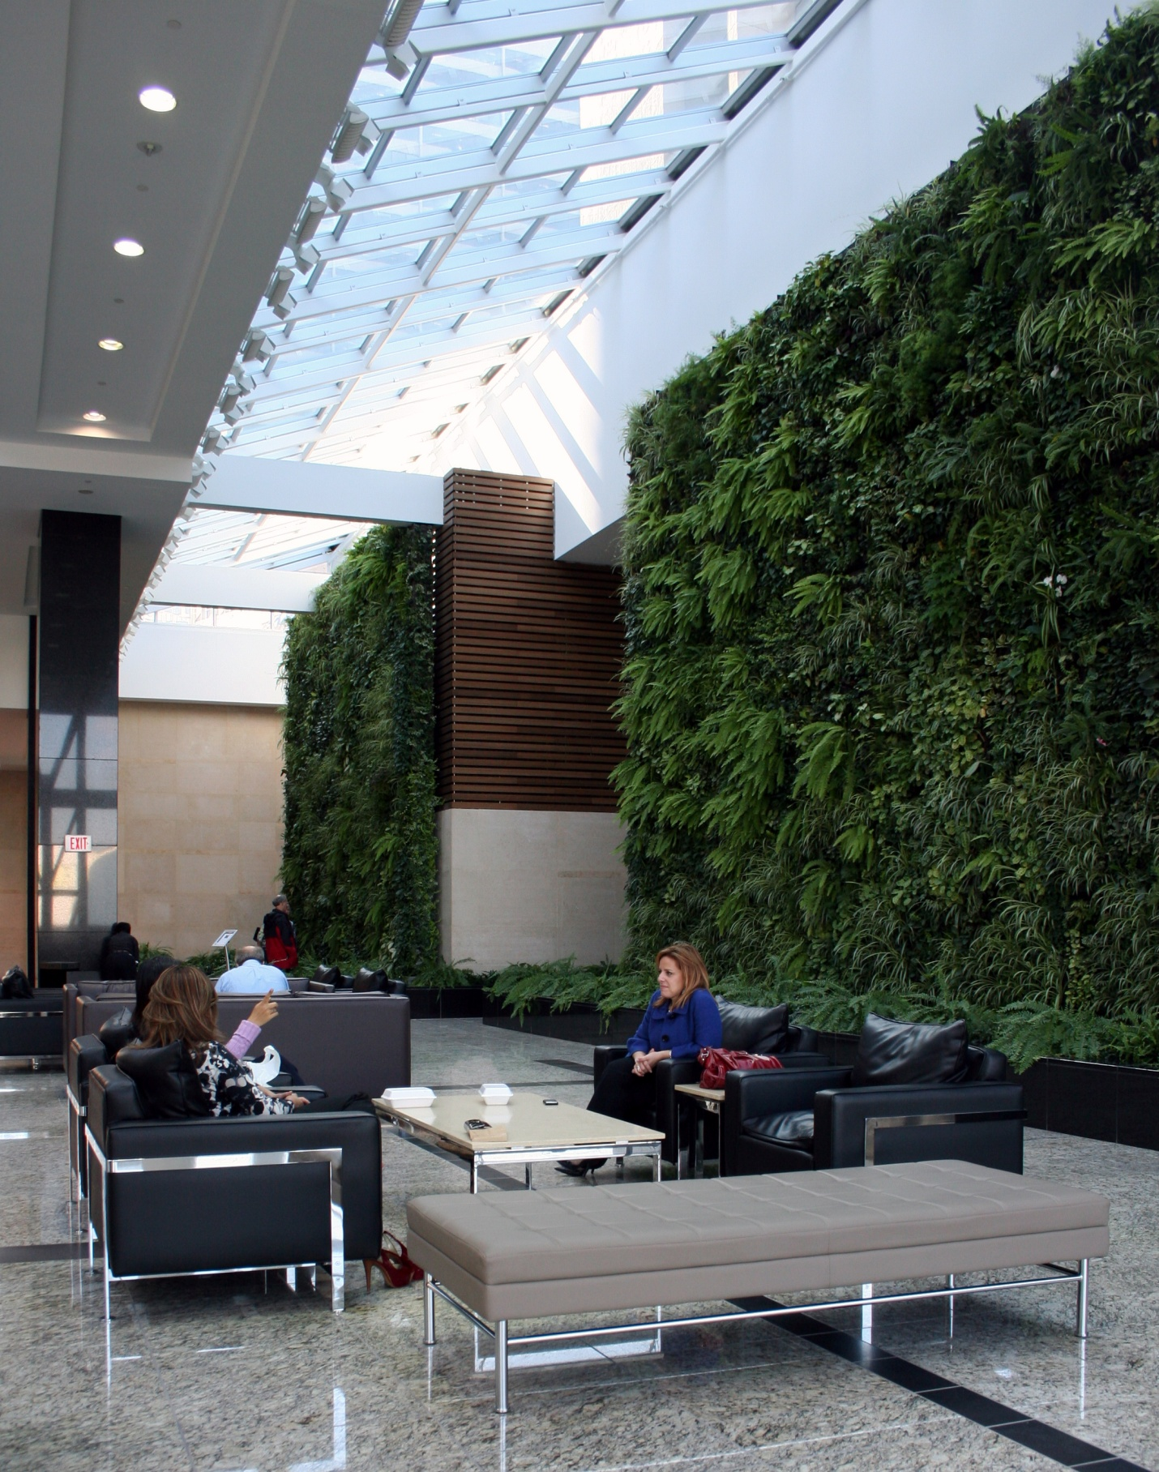
You probably
already know...
plants create an aesthetically pleasing atmosphere,
Notes:
Photo: McCaren Designs

Slide 3
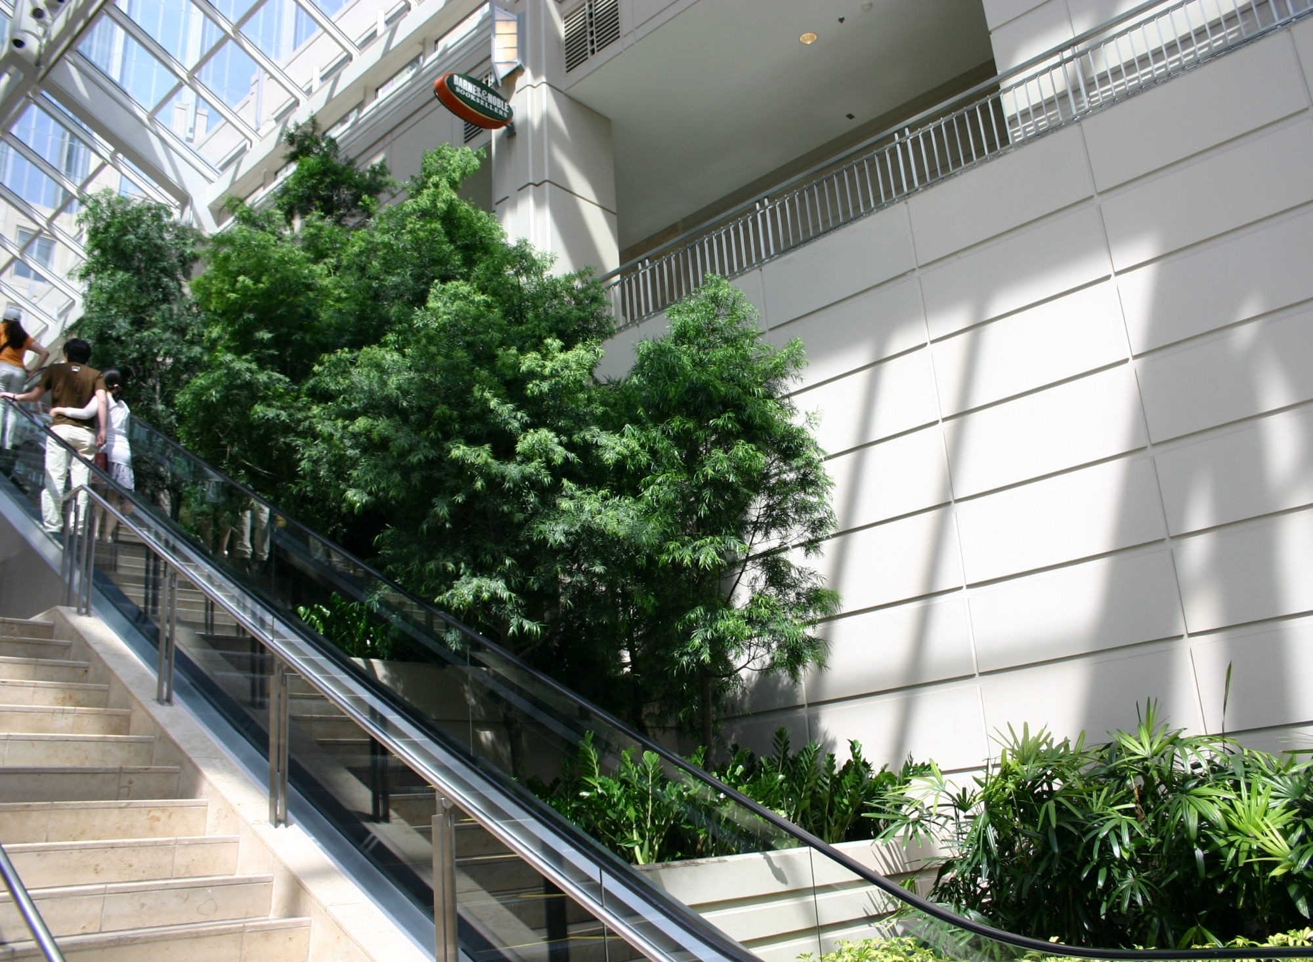
You probably
already know...
they improve people’s perception of a facility.
Notes:
Photo: Janice Goodman, Cityscapes, Boston.

Slide 4
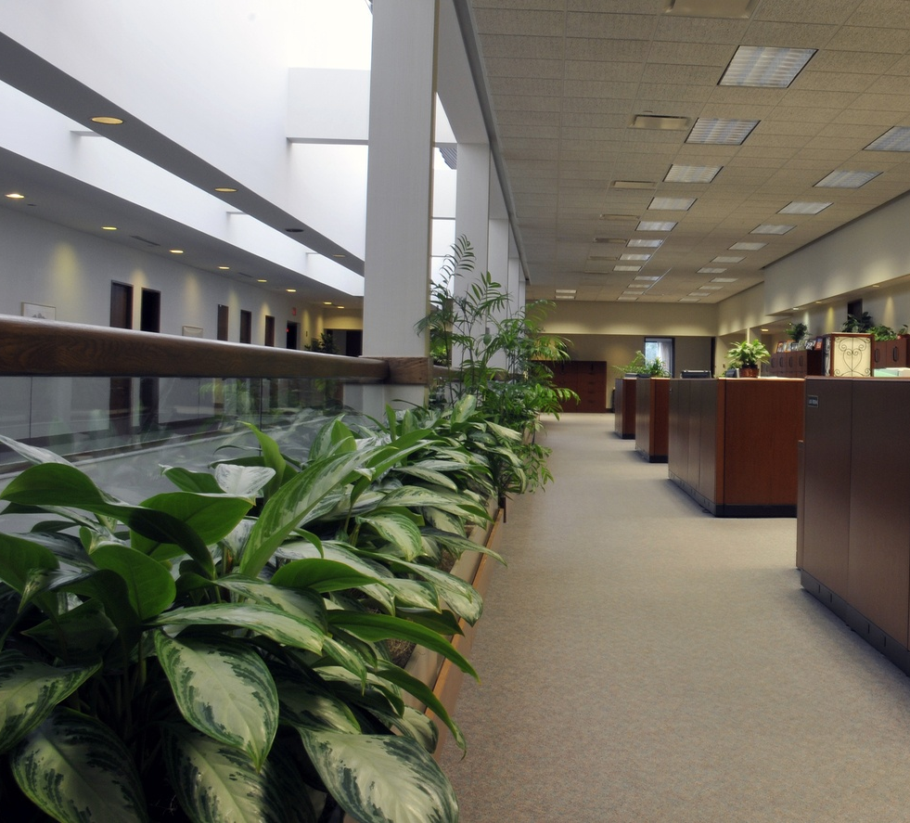
You probably
already know...
plants clean the air we breathe.
Notes:
Photo: Bigstock

Slide 5
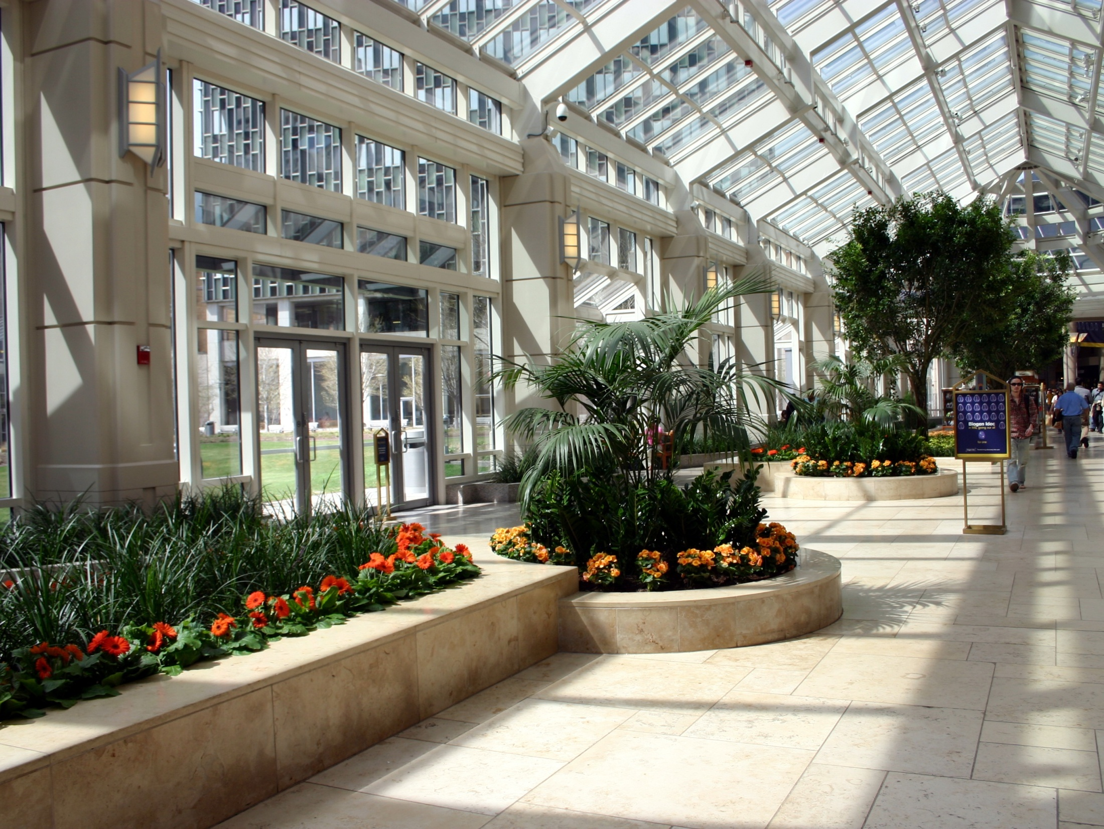
You might also have heard...
plants increase profits through their positive affect on people,
Notes:
Photo: Janice Goodman, Cityscapes, Boston.

Slide 6
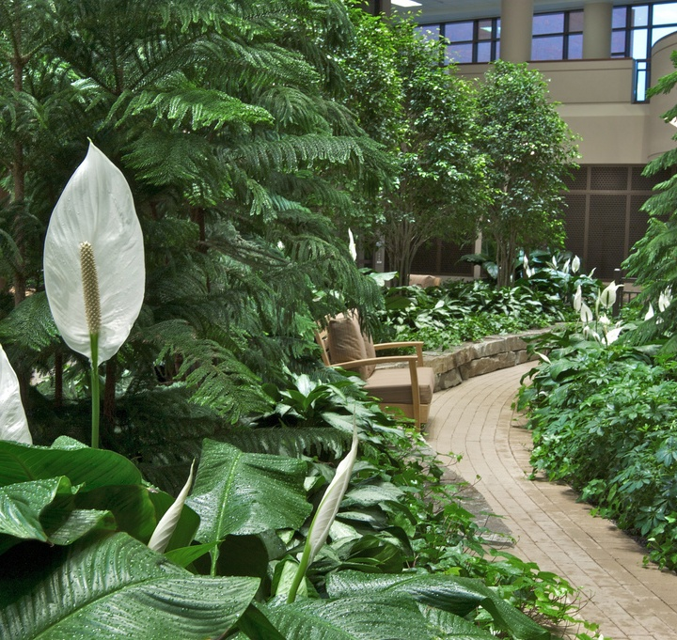
You might also have heard...
plants reduce employee stress,
Notes:
Photo: Henry Ford Hospital, West Bloomfield, MI

Slide 7
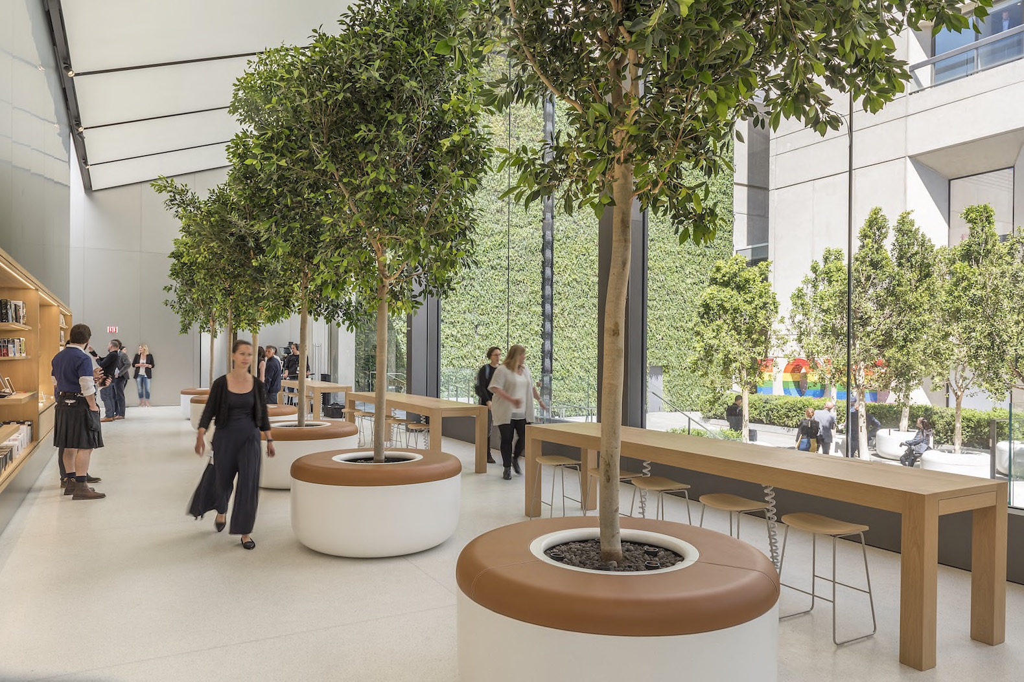
You might also have heard...
they reduce employee absenteeism.
Notes:
Photo: Apple Store at Union Square, Foster + Partners by Nigel Young

Slide 8
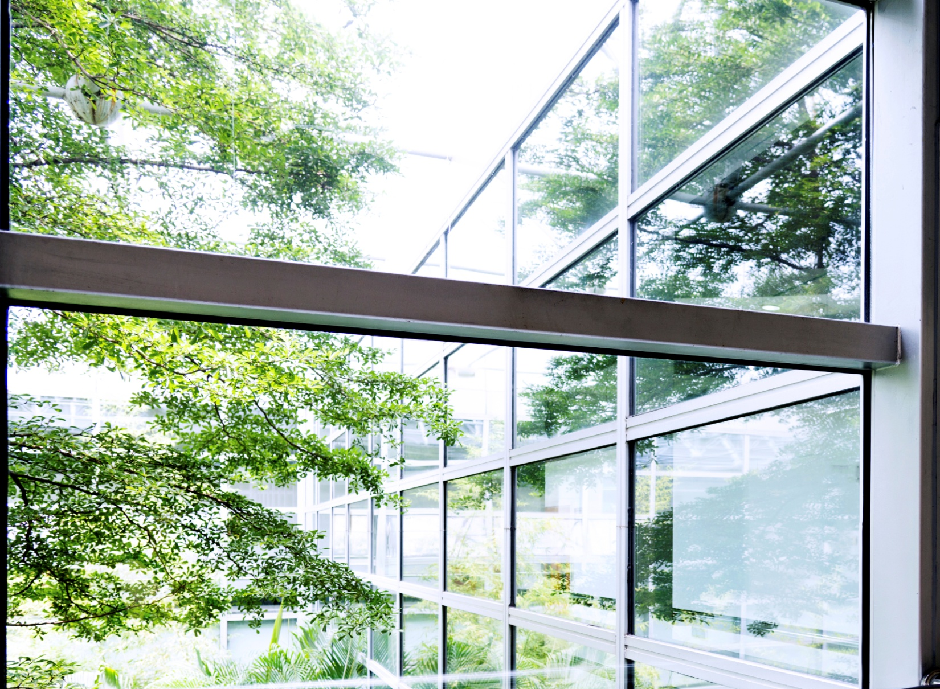
You might also have heard...
plants improve creativity and problem solving.
Notes:
Photos: Istock

Slide 9
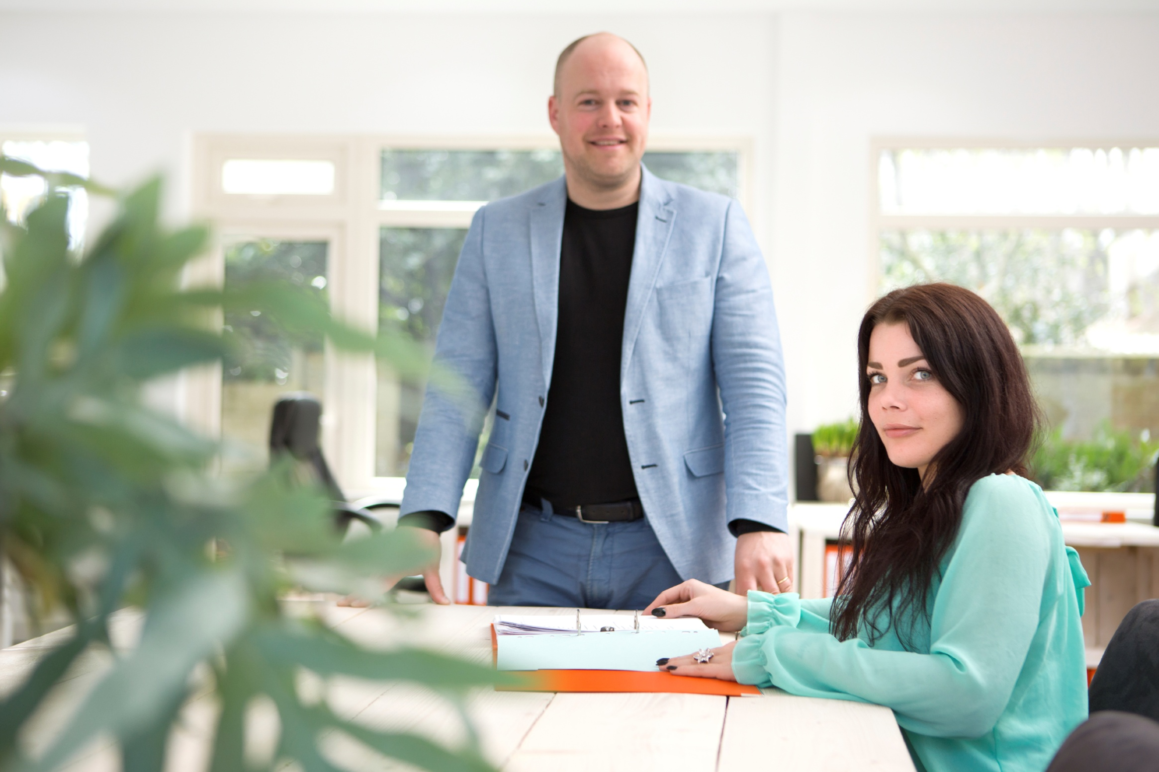
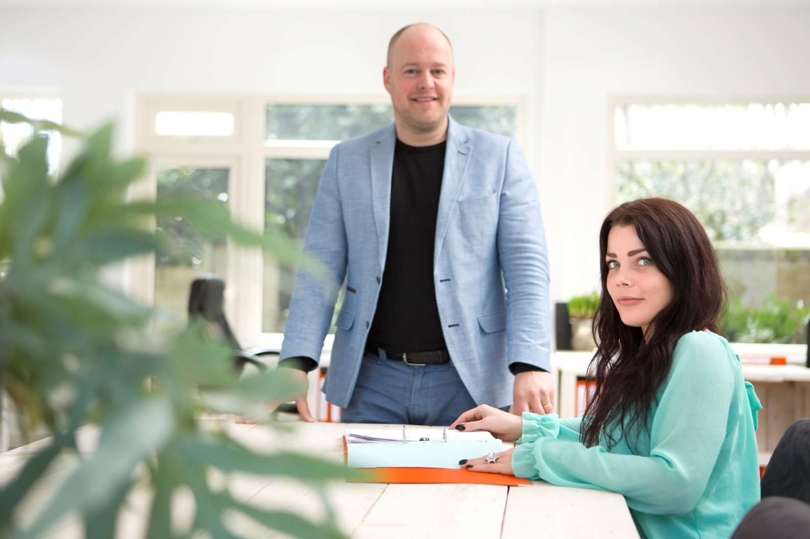
When exposed to interior foliage, people just have more positive emotions!
Notes:
Photo: McRae Anderson, McCaren Designs, St. Paul, MN. Location: Planterra, West Bloomfield, MI

Slide 10
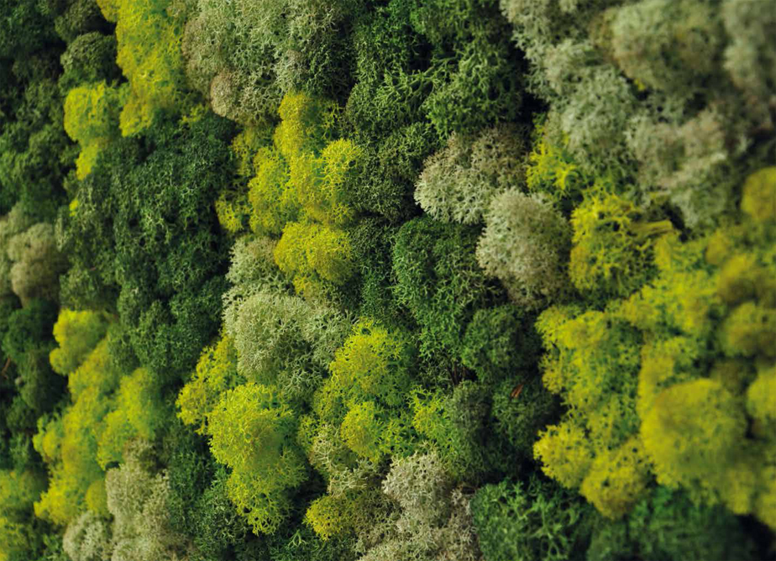
So, what are you waiting for?
Attract, retain, soothe and inspire with plants!
Notes:
Photo:

